Slide 1
HYDEX funding opportunities 13 May 2022
At the forefront of energy transformation

Slide 2
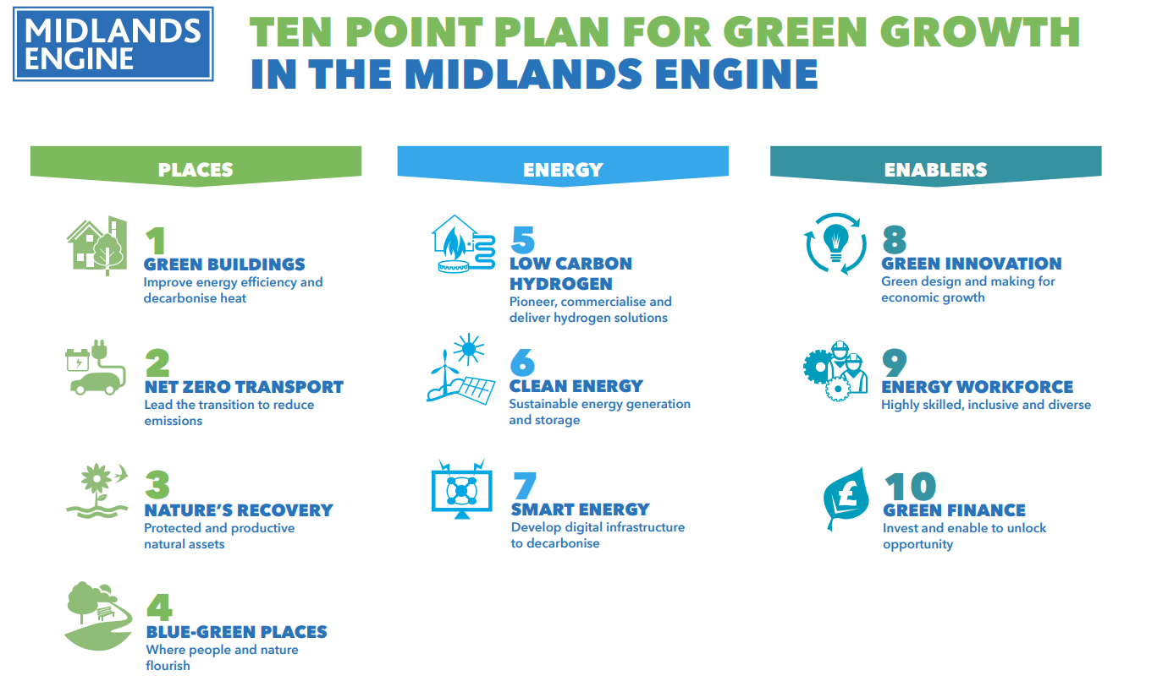
Notes:
Summer 2021

Slide 3
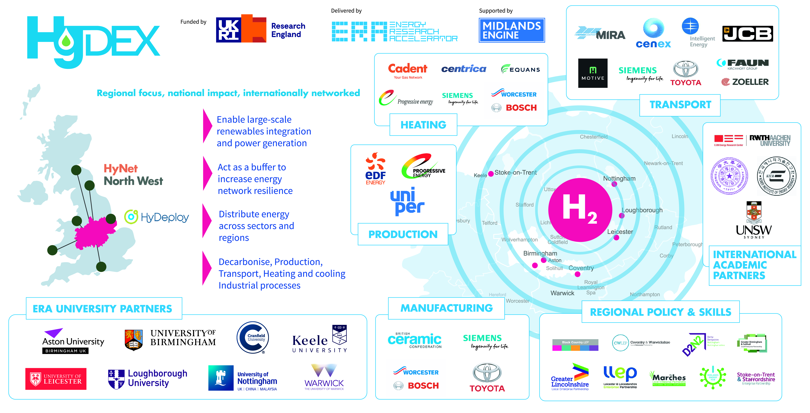
Access to large scale demonstrator and test facilities
Support for technology development and R&D
Support for IP development and commercialisation
Development of hydrogen skills and expertise in businesses
Civic engagement and policy activities to build understanding
Development of access to international markets and inward investment

Slide 4
Agenda
1. Funding Opportunities Update
Net Zero Hydrogen
Industrial Hydrogen Accelerator
Industrial Energy Transformation Fund
Strategic Investment Funds
2. Quick update on H2GVMIDS
3. Quick Intro to South Korea Twin Cities

Slide 5
BEIS / Innovate UK Hydrogen Programme
At the forefront of energy transformation

Slide 6
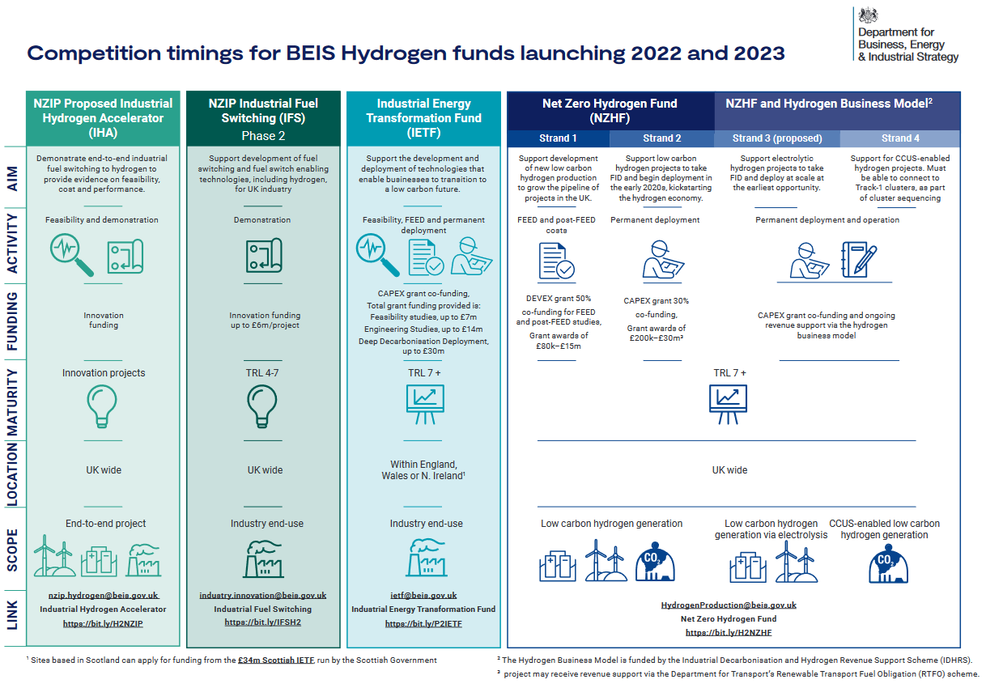

Slide 8
Net Zero Hydrogen Fund
Net Zero Hydrogen Call - £90M across initial 2 strands
Supporting Hydrogen Production Infrastructure accelerated development – Open 25/4/22
Strand 1 Front End Engineering Development and post FEED (submit by 22/6/22)
Build a pipeline of viable projects for future funding
Preparation of engineering construction plan
Strand 2 CAPEX (submit by 6/7/22)
Focus on construction of low-carbon H2 facilities
Electrolysis, methane reforming or gasification

Slide 9
Eligibility criteria
 | Strand 1 – Development Expenditure (DEVEX) | Strand 2 – Capital Expenditure (CAPEX)
Project eligibility | lead must be a UK registered business of any size open to single applicants and collaborations must carry out your project in the UK exploit the results from or in the UK meet the draft low carbon hydrogen standard be using core technology that has been tested in a commercial environment, Technology Readiness Level (TRL) 7 or more
Total grant | between £80,000 and £15 million | between £200,000 and £30 million
Project length | between 6 and 15 months | between 6 and 27 months
Project dates | Start by 1st January 2023 End by 31st March 2024 | Start by 1st January 2023 End by 31st March 2025

Slide 10
Funding
 | Strand 1 – Development Expenditure (DEVEX) | Strand 2 – Capital Expenditure (CAPEX)
Total grant | 50% of eligible costs if you are a UK registered business of any size | 30% of eligible costs if you are a UK registered business of any size
For research organisations conducting fundamental research you could get funding for your eligible project costs of up to 100%. (Maximum 30% of total project value)
Notes:
If the majority of your organisation’s work on your project is commercial or economic, your funding request must not exceed the limits below. These limits apply even if your organisation normally acts non-economically.
For developmental expenditure (DEVEX) support, you could get funding of up to 50% of your eligible project costs if you are a UK registered business of any size
For capital expenditure (CAPEX) support, you could get funding for your eligible project costs of up to 30%

Slide 11
Key Dates
Timeline | Strand 1 (DEVEX) | Strand 2 (CAPEX)
Competition Opens | 25th April 2022 | 25th April 2022
Briefing Event | 26th April 2022 | 26th April 2022
Submission Deadline | 22nd June 2022 11:00 | 6th July 2022 11:00
Interviews | 5th September 2022 (w/c) | 12th September 2022 (w/c)
Applicants notified | 23rd September 2022 | 30th September 2022
Notes:
These are the key dates to bear in mind for this competition. It’s important to note that the submission deadline is at 11am on the dot. IFS will automatically close then and so after this time applications can’t be submitted. We strongly recommend that you submit your application as early as possible as traffic will be high on deadline day.
Please contact customer support in advance of the deadline if you experience any difficulties with submitting your application so that we can assist you in good time.

Slide 12
Net Zero Hydrogen
Potential Project Areas
Strand 1 DevEx
Front end engineering design (FEED) and post-FEED studies. The aim is to build the pipeline of hydrogen production projects and measurably move them closer to deployment. This competition supports multiple hydrogen production pathways. Project must address low carbon hydrogen (see calculator tool)production opportunities studies or both.
FEED studies can include:
equipment definition (equipment data sheets, specifications)
equipment pricing (bid lists, bid packages)
plant layout & model (plot plan)
material quantification (material take-off, physical drawings)
engineering, procurement and construction (EPC) execution planning (EPC schedule, contract plan)
cost estimation (capital costs, operating costs)
commercial proposal (cost, schedule, performance guarantees)
environmental impacts and mitigation
Post-FEED and pre-final investment decision (pre-FID) studies can include:
refinement of the outputs of FEED, particularly the cost estimates
planning applications

Slide 13
Net Zero Hydrogen
Potential Project Areas
Strand 2 CapEx
Project must address low carbon hydrogen production opportunities and must focus on construction of new low carbon hydrogen production facilities.
Credible projects to utilise one of the following hydrogen production types:
electrolysis
methane reforming
Gasification
Portfolio of Projects sought
geographical location | project scale and replicability
project cost and funding available | Project timescales
hydrogen production technology type | hydrogen production commercial readiness
alignment with and contribution to wider cross-economy decarbonisation | environmental impacts
use of additional low carbon electricity | affordability considerations, for example, longer term cost to the taxpayer
projects awarded funding through related BEIS and UKRI competitions | Offtaker type

Slide 15
Industrial Hydrogen Accelerator
Launch /Briefing
9/5/2022
£26M Fund
End-End H2 System
Production
Storage/Transport
End Use

Slide 18
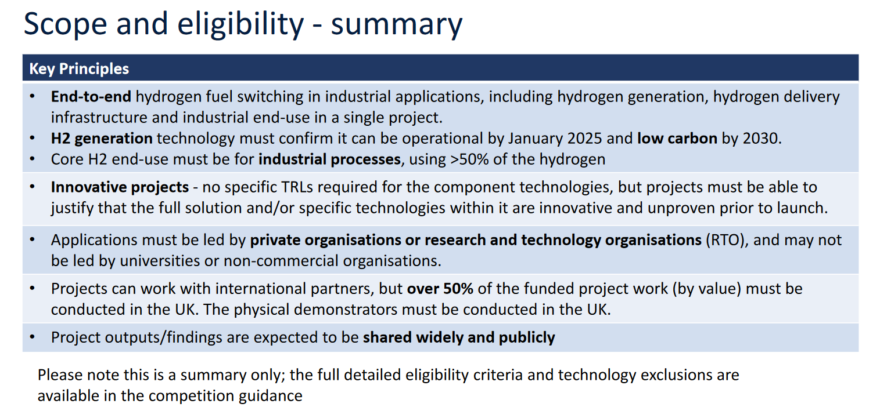
Industrial Hydrogen Accelerator
Eligibility
Scope
Dates
Application Method

Slide 19
Industrial Hydrogen Accelerator
Potential Project Areas
IHA Suitable for project design or predesigned project with agreed timeline
End-to-End
Production of Hydrogen
Transportation / Storage
Industrial or Commercial Off take.

Slide 20
Industrial Energy Transformation Fund
The IETF is designed to help energy intensive businesses
cut their energy bills and;
carbon emissions
investment in energy efficiency and low carbon technologies.
Phase 2 £70M fund (phase 3 in Autumn £60M)
Opens 30/5/22, Close 09/09/22 – Project Completion by 3/3/2025
Eligible: Manufacturing, Recycling, Data Centres
Funding applied for Minimum threshold per application Maximum threshold per project
Energy efficiency deployment £100,000 £14 million
Deep decarbonisation deployment £100,000 £30 million
Engineering studies £50,000 (total eligible cost) £14 million
Feasibility studies £30,000 (total eligible cost) £7 million

Slide 21
Industrial Energy Transformation Fund
Potential Project Areas
Decarbonisation for manufacturing and materials recovery
Use of renewable energy
Heat Recovery and reuse
Use of hydrogen technology
Blended gas use in processes
Use of Fuel Cell technology e.g. SOFC for power and heat
Industries?
Foundries and metal treatment
Ceramics
Recycling
Online IETF Phase 2 briefing webinar, Wednesday 8 June 2022, 10am to 12.45pm

Slide 23
UKSIF (OFGEM/Innovate)
Provides funding for the Electricity System Operator, Electricity Transmission, Gas Transmission and Gas Distribution sectors.
Find and fund ambitious, innovative projects with the potential to accelerate the transition to net zero.
Investing £450m in energy network innovation from 2021-2026
Objective to help transform the UK into the ‘Silicon Valley’ of energy, making the UK the best place for high potential businesses to grow and scale in the energy market.
Four Innovation Challenge areas. These are:
Whole system integration
Data and digitalisation
Heat
Zero emission transport

Slide 24
Strategic Objectives of the SIF
Ofgem and Innovate UK are collaborating to:
Deliver a net zero energy system at lowest costs to consumers
2) Position the UK as the ‘Silicon Valley’ of energy systems
We are interested in big, bold, ambitious ideas which will significantly accelerate delivery of net zero in the UK and be rolled out internationally.
Notes:
One of the cool things about this fund is that we’re combining two different organisational objectives, the first is Ofgem’s focus to deliver a net zero energy system at lowest cost to consumers and the second is Innovate’s desire to try and turn the UK into the ‘silicon valley of energy’. What we mean by that is we want to make the UK the best place in the world for innovative energy businesses and academics to grow and scale their ideas and enterprises leading to UK jobs and economic growth. We want the UK to become a magnet for energy investment leading to national and international opportunities. All whilst delivering for our most important stakeholders – energy network users and consumers.

Slide 25
The 3 pillars of the Strategic Innovation Fund
Strategic Alignment
Agile ‘Challenges’
Commercialisation
Bring in the best businesses and academics from across energy and other sectors
1. Whole system integration
Network Roll Out
2. Heat
3. Data and Digital
4. Zero emissions transport
Investor Expert Panel
Aligning energy innovation funding across government, UKRI and Ofgem
Discovery Projects
2 months / £150k
Utilities Expert Panel
Alpha Projects
6 months / £500k
International route to market (networks, utilities, investors)
Enabling responsive policy and regulatory change informed by innovation
Beta Projects
c.4 yrs / c. £10m+
Notes:
So how does the fund work in practice? Well it is split into three key activities (the dark blue boxes on this slide), strategic alignment, agile challenges and commercialisation.
The strategic alignment piece is all about a) bringing in the best ideas in from across and beyond the energy sector. We want to crowd in some of the capability UKRI supports across space, defence, flight, transport, robotics, as well as energy storage, local energy systems, industrial decarbonisation and low cost nuclear. From across the water sector, buildings, communications and healthcare, from across investors, start ups and scale ups. We want to massively broaden the kinds of ideas and participants in the SIF to help the energy networks to think and do in different ways.
But it’s also about making it easier for innovators to innovate by lining the SIF up behind other government energy innovation funds, and you’ll hear a but more about that from Sally at BEIS later.
At the centre of the Strategic Innovation Fund’s delivery model is a series of flexible, responsive, agile challenges that are incredibly easy for networks to apply in to. Challenges form the backbone of everything we do. We’ve worked with stakeholders and Ofgem to select the four key initial challenges. Whole System integration, Data and Digitalisation, Heat and Zero Emission Transport. These are the major challenges of our time but next years challenges could be different, we will respond with new challenges as needed. We may even open up a ‘challenger round’ – something that could be open all year round for left field ideas that don’t fit the core challenges.
And we will be delivering these challenges in phases, discovery, alpha, beta in a “fail-fast” approach. Starting with a high volume of small or short projects, identify the best ideas quickly, and soon refine this to a smaller volume of larger or longer projects. Failing after discovery is completely ok, all lessons will be captured and shared. It’s the failure to discover in the first place which would be much, much worse.
Discovery projects are capped at two months long and £150,000 of funding. Alpha projects can be up to £500,000 and run for six months. There is no funding cap on beta projects, so this is where real demonstration comes to life. You can’t do an alpha or beta without having successfully passed the discovery and alpha stages.
This initial application stage is for the discovery phase projects only and projects must be led by either gas distribution, gas transmission, electricity transmission or the system operator. DNO’s will be able to lead in the coming years and we’re working to explore if third parties can lead too in time (bear with us on that one). Despite networks needing to submit the discovery applications, they can subcontract the work to the most innovative third parties, you’ll hear more about this shortly. If you’re not a network please don’t try to apply on your own as you will not be eligible.
And then we get into the commercialisation. Our intention is that beta projects should be aiming for ‘business as usual (BAU)’ adoption of their product or service as fast as possible. To support this ambition, we will set up a new function to to help the businesses working with the energy networks to scale up and to attract investment if they need. We will shortly be hiring a head of commercial innovation, keep an eye out for that one if this could be you!

Slide 26
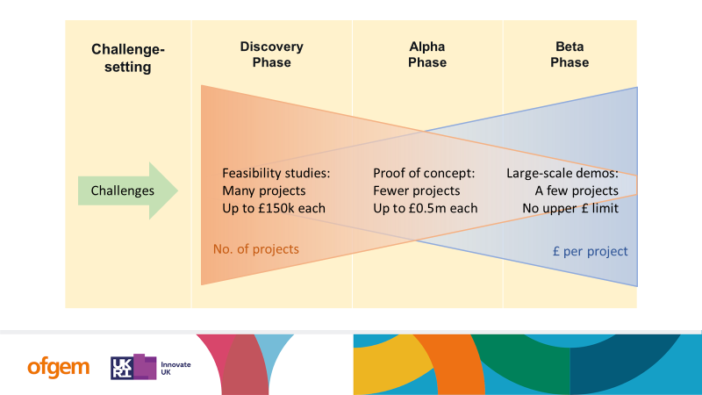

Slide 27
SIF 2022 Round 2 timelines overview
Jan
Feb
Mar
Apr
May
Jun
Jul
Aug
Sept
Oct
Nov
Dec
Challenges
Ideation
Incubation
Acceleration
February
3rd party consultation on challenges
March
Challenge prioritisation survey to stakeholders
April
Publication on intended high-level Challenges overview for 2022
May
Publication of final position on high-level Challenge areas
TBD
SIF team engagement with third parties with innovation ideas
Brokerage for innovators with networks
July
Detailed Innovation Challenges and application submission documents published
Sept
SIF Round 2 formally open for Discovery applications
ENIC conference – engagement with SIF team
November
Application for SIF Round 2 Discovery Phase applications closed
Dec
Applications evaluated with view to decisions in Jan 2023

Slide 28
Key themes for Challenge 2
Supporting a Just Energy Transition
Preparing for a net zero power system
Improving Energy Resilience and robustness.
Accelerating decarbonisation of major energy demands

Slide 29
Hydrogen Project Ideas
For Further Information: David Terry - ERA David.Terry@ERA.ac.uk 07812 781774
Jacob Vivian – Midlands Engine Jacob.Vivian@midlandsengine.org
Faye McAnulla – ERA, HyDEX faye.mcanulla@era.ac.uk
Sharon George – HyDEX, Keele s.m.George@keele.ac.uk

Slide 30
HyDEX and H2GV Mids
At the forefront of energy transformation

Slide 31
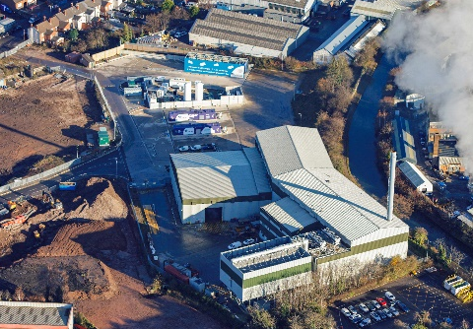
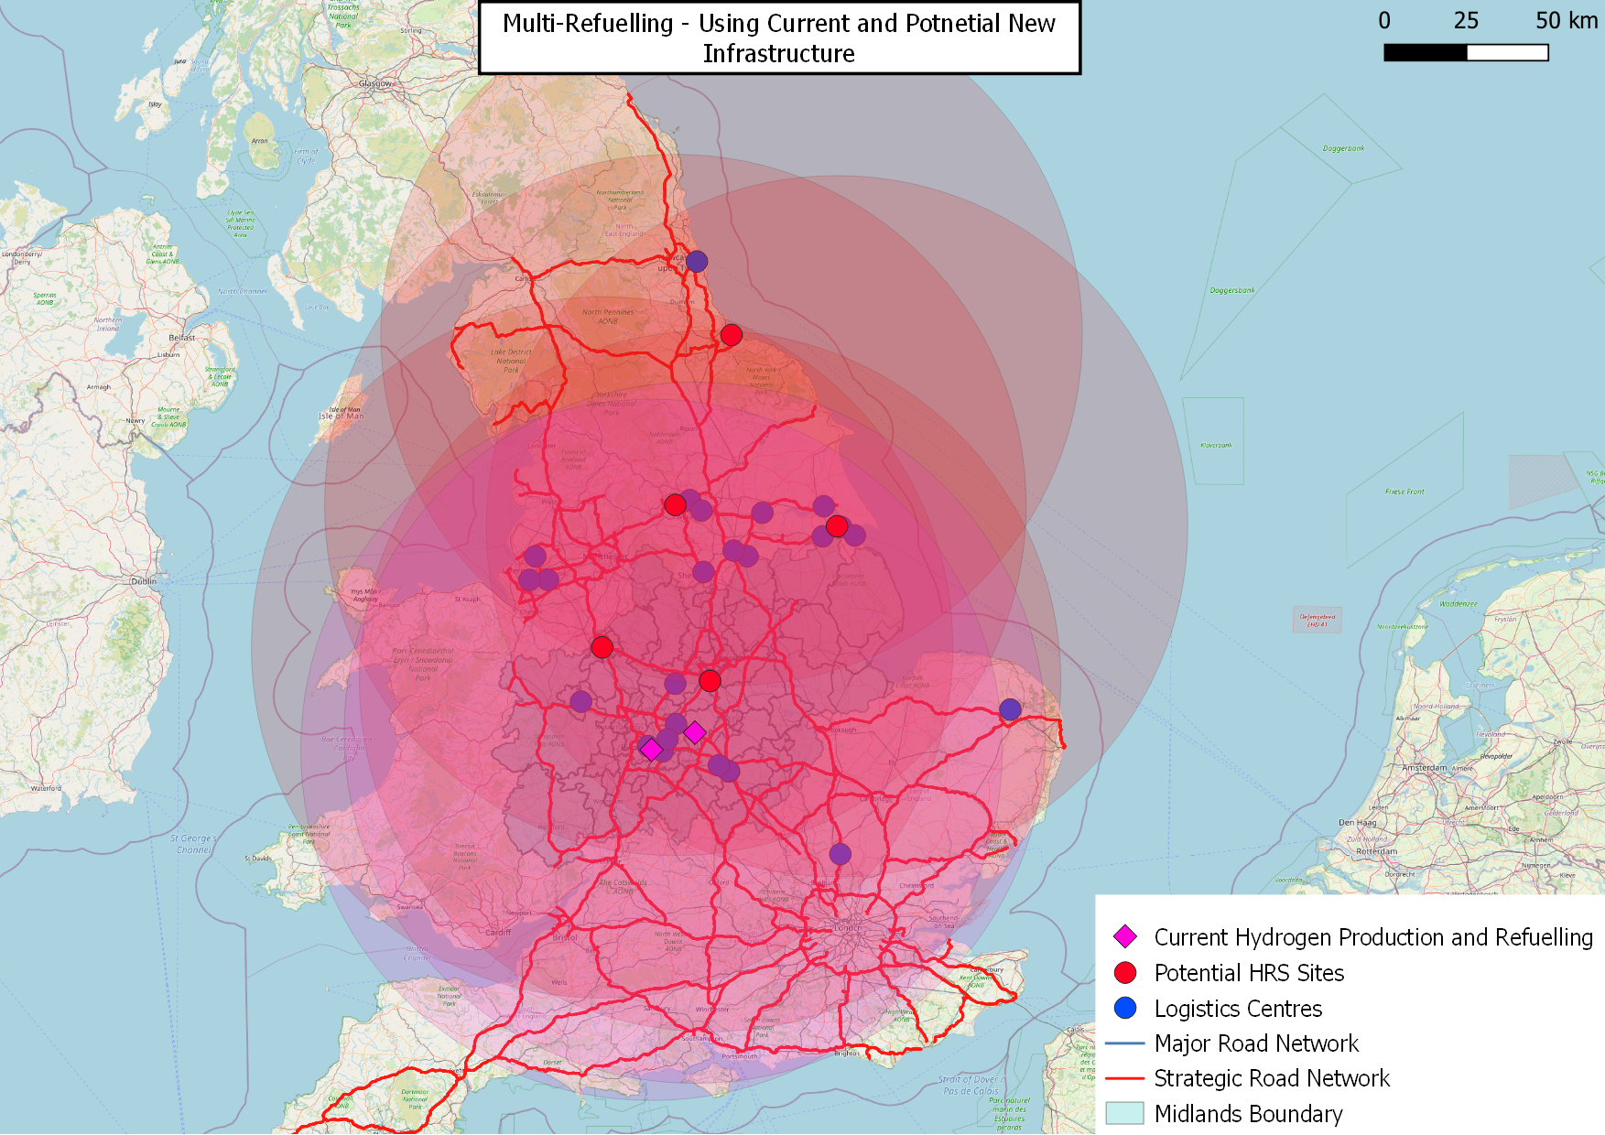
Overview of the Demonstrator Proposal
H2 trucks
H2 Refuelling
Logistics
Leasing Company
Supply chain
Skills
Source: MDSTransmodal GB Freight Model
Notes:
Supply and demand issue at present.
Programme aims to build market confidence such that:
hydrogen refuelling infrastructure is installed, but in the right place and with the right capacity.
hydrogen trucks are supplied to regional freight and logistics organisations.
freight and logistics organisations are provided with a low-risk, low additional cost, opportunity for trialling the hydrogen HGVs.
Presently, only one large-scale refuelling station is available in the region at Tyseley Energy Park, TEP,
No market ready hydrogen trucks immediately available for deployment at scale
Logistics sector, which operates on tight margins, is nervous of absorbing the risk of a new-to-market vehicle.

Slide 32
Introduction to Demonstrator
Planned Start Feb 2023, 5 year programme
Trial different trucks as they become available
Trial different use-cases for different end users
March ‘23 onwards
Phase 1: Back to base MIRA and Tyseley
Sep ‘23 onwards
Phase 2: Back to base (Selected Routes)
Sep ‘25 onwards
Phase 3: Multiple longer journey routes (Open Network)

Slide 33
Introducing the HyDEX programme
HyDEX (era.ac.uk)

Slide 34
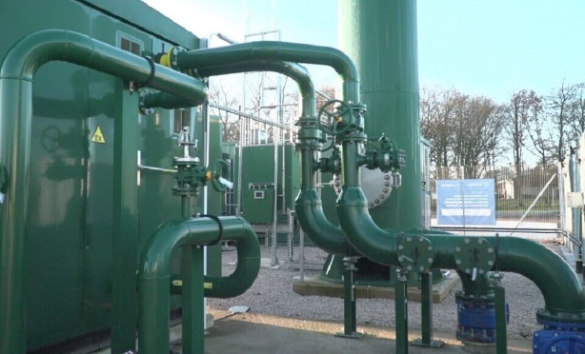
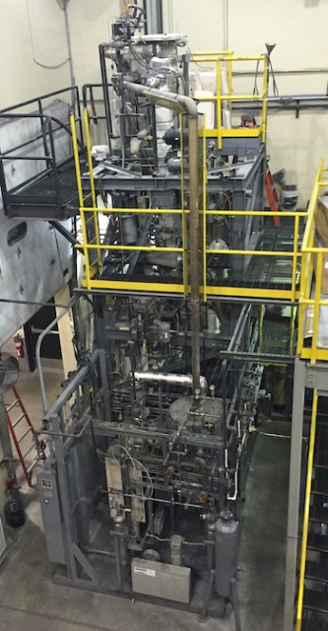
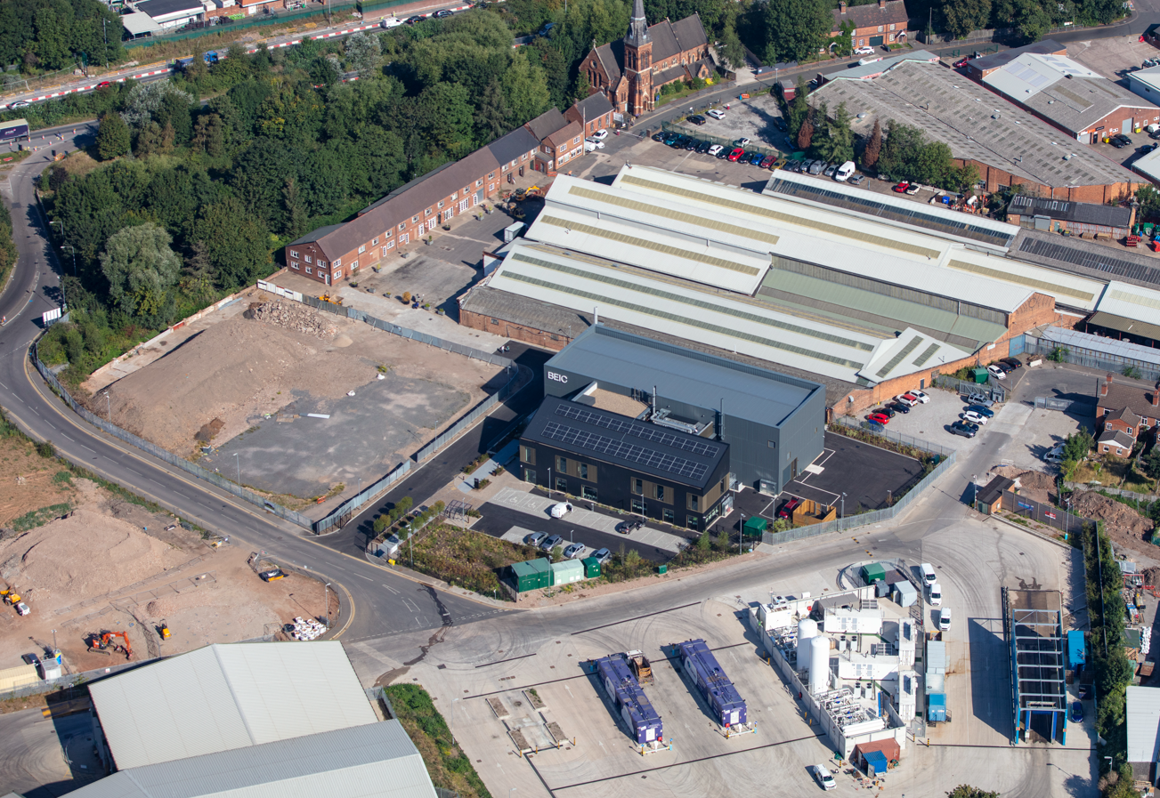
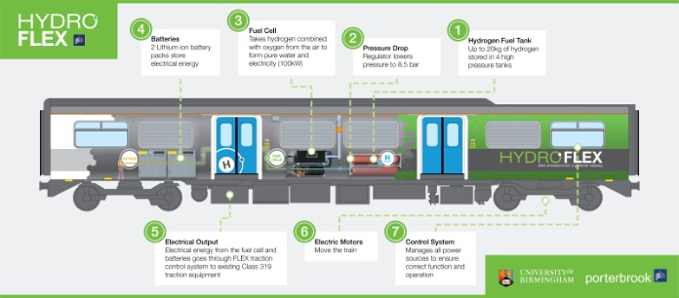
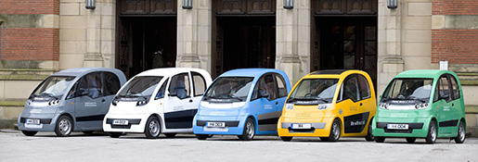

Slide 35
Access to large scale demonstrator and test facilities
Support for technology development and R&D
Support for IP development and commercialisation
Development of hydrogen skills and expertise in businesses
Civic engagement and policy activities to build understanding
Development of access to international markets and inward investment

Slide 36
Output KPIs
Number of new R&D Programmes (>25) and green book applications (>5)
Number of commercial opportunities generated (>10)
New hydrogen demonstration infrastructure and vehicles at sites (>3)
New products and services developed (>20)
Number of organisations (SMEs and OEMs) directly and indirectly benefiting (>100) from the demonstrators plus large businesses (>10)
New jobs directly associated with industrial and research partners (>200)
Number of people successfully receiving direct training (50 businesses/100 people)
Number of people attending workshops and annual stakeholder event (>200)
New policy reports and commissions (2)
Monitoring Equality, Diversity and Inclusivity across the programme
Significant international investment and knowledge exchange inputs to the UK related to the programme (>3)

Slide 37
Capital Plans under development
University | Proposed Capital Plan | Contact
Aston University | Focus on production and fuel cells: gasification; pyrolysis; Impact through access to facility and training opportunities | Amirpiran Amiri
University of Birmingham | Tyesley Energy Park BEIC Ammonia cracker going into TEP Focus on local transport infrastructure supporting commercial fleet evolution (refuelling between Edgbaston and Tyseley) | Robert Steinberger-Wilckens
Cranfield University | Catalytic methane cracking for hydrogen production Quality assessment; blended hydrogen formulations; interacting with supercapacitor and battery manufacturers Turquoise Hydrogen demonstrator | Peter Clough; Upul Wijayantha-Kahagala-Gamage
Keele University | Green Hydrogen from renewables via Keele Smart Energy Network 100% hydrogen ceramics manufacture trial | Sharon George (PI)
University of Nottingham | "Flex Dual Fuel" demonstrator engine with ability to flex between H₂ and ammonia (NH₃) dual fuelling as an advanced retrofit solution for existing heavy duty diesel engines, including solid state hydrogen storage | Simon Gerrard
University of Warwick | Novel green hydrogen production facility with over 90% energy efficiency | Sai Gu

Slide 38
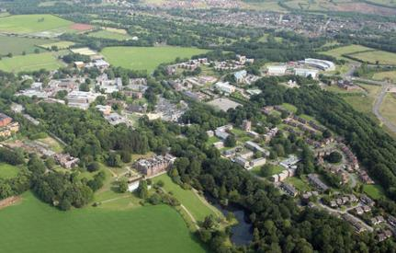
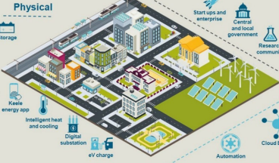
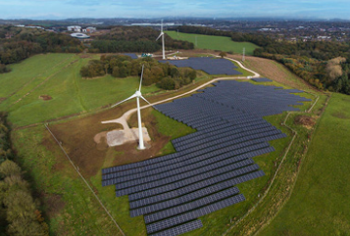
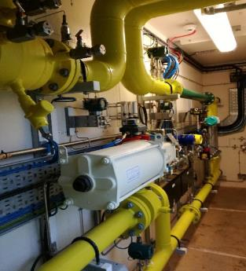
Keele University Energy Campus
Opportunity to develop smart green hydrogen
Capturing and storing renewable energy for on-site use
Working with ceramics and steel sectors to provide green energy into high temperature manufacturing
Keele University has its own gas and electricity network
HyDeploy demonstrated 20% gas blend
SEND (Smart Energy Network Demonstrator) helps balance campus electricity energy

